Slide 1
Unit 4: Hybrid Electric Vehicles
Dr. Sachin Argade

Slide 2
History of Hybrid Vehicles
Gasoline-electric hybrid rail-car propulsion system in early 1889 -William H Patton from USA
1899 Pieper establishment from Belgium and Vendoveli and Priestley Electric Carriage company France.
Parallel hybrid with a small air-cooled gasoline engine assisted by an electric motor and lead–acid batteries - Pieper
Another tricycle with series hybrid was created by Vendoveli and Pristely .

Slide 3
History
Camille Jenatzy presented a parallel hybrid vehicle at the Paris Salon of 1903.
A 6 hp gasoline engine with a 14 hp electric machine
H. Krieger, built the second reported series hybrid vehicle in 1902.
His design used two independent DC motors driving the front wheels.
They drew their energy from 44 lead–acid cells that were recharged by a 4.5 hp alcohol spark-ignited engine coupled to a shunt DC generator.

Slide 4
History
Parallel and series type HEVs , were built during a period ranging from 1899 until 1914.
Lohner-Porsche vehicle of 1903:
used dynamic braking by short circuiting or by placing a resistance in the armature of the traction motors.
Power electronics did not become available until the mid-1960s
The greatest problem that these early designs had to cope with was the difficulty of controlling the electric machine.

Slide 5
History
In 1975, Dr. Victor Wouk, along with his colleagues built a parallel hybrid version of a Buick Skylark
The engine was a Mazda rotary engine, coupled to a manual transmission.
It was assisted by a 15 hp separately excited DC machine, located in front of the transmission.
Eight 12 V automotive batteries were used for energy storage.
A top speed of 80 mph (129 km/h) was achieved with acceleration from 0 to 60 mph in 16 sec.

Slide 6
History
The series hybrid design was revived by Dr. Ernest H. Wakefield in 1967, when working for Linear Alpha Inc.
A small engine-AC generator, with an output of 3 kW, was used to keep a battery pack charged.
Other approaches studied during the 1970s and early 1980s used range extenders,
similar in concept to the French Vendovelli and Priestly 1899 design.
Other prototypes of hybrid vehicles were built by
The Electric Auto Corporation in 1982
And by the Briggs & Stratton Corporation in 1980.
Both of these were parallel hybrid vehicles.

Slide 7
History
Two oil crises of 1973 and 1977, growing environmental concerns (still not single HEV)
Focus was drawn by the electric vehicles (1980’s)
The lack of interest in hybrid electric vehicles
during this period may be attributed to the lack of practical power electronics, modern electric motors, and battery technologies.
1990s The Ford Motor Corporation initiated the Ford Hybrid Electric Vehicle Challenge,
which drew efforts from universities to develop hybrid versions of production automobiles.

Slide 8
History
In the U.S., Dodge built the Intrepid ESX 1, 2, and 3.
The ESX-1 was a series hybrid vehicle, powered by a small turbocharged three cylinder diesel engine and a battery pack.
Two 100 hp electric motors were located in the rear wheels.
The Ford Prodigy and GM Precept
The U.S. government launched the Partnership for a New Generation of Vehicles (PNGV), which included the goal of a midsize sedan that could achieve 80 mpg.
Parallel hybrid electric vehicles powered by small turbocharged diesel engines coupled to dry clutch manual transmissions
Both of them achieved the objective, but production did not follow.

Slide 9
History
French Renault Next
Efforts in Europe
a small parallel hybrid vehicle using a 750 cc spark-ignited engine and two electric motors.
This prototype achieved 29.4 km/l (70 mpg) with maximum speed and acceleration performance comparable to conventional vehicles.
Volkswagen Chico
a small electric vehicle, with a nickel–metal hydride battery pack and a three-phase induction motor.
A small two-cylinder gasoline engine was used to recharge the batteries and provide additional power for high-speed cruising

Slide 10
History
The most significant effort in the development and commercialization of hybrid electric vehicles was made by Japanese manufacturers
In 1997,
Toyota released the Prius sedan in Japan.
Honda also released its Insight and Civic Hybrid.
Toyota Prius and Honda Insight vehicles have a historical value
As they are the first hybrid vehicles commercialized in the modern era to respond to the problem of personal vehicle fuel consumption.

Slide 11
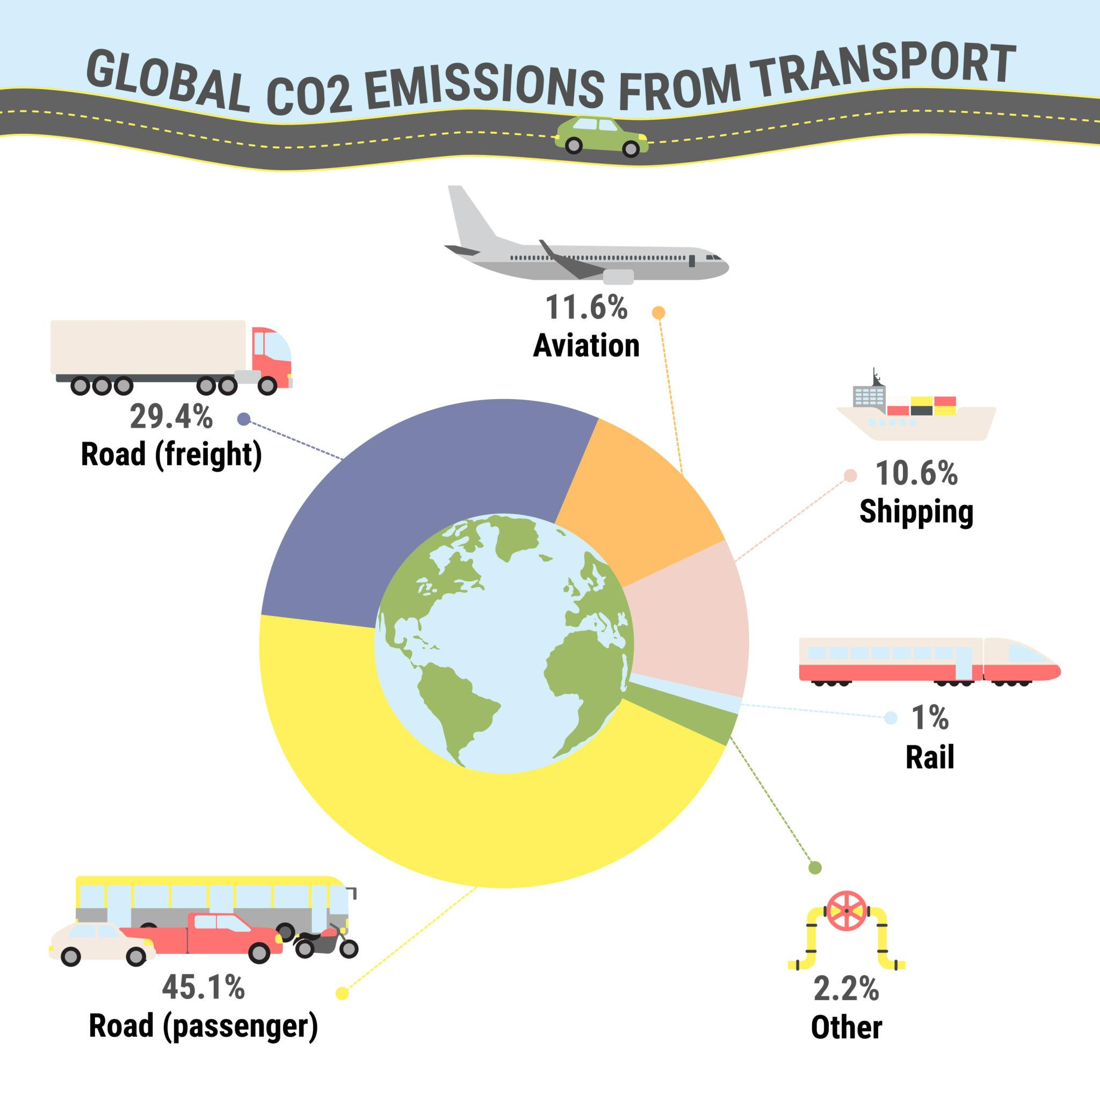

Slide 12
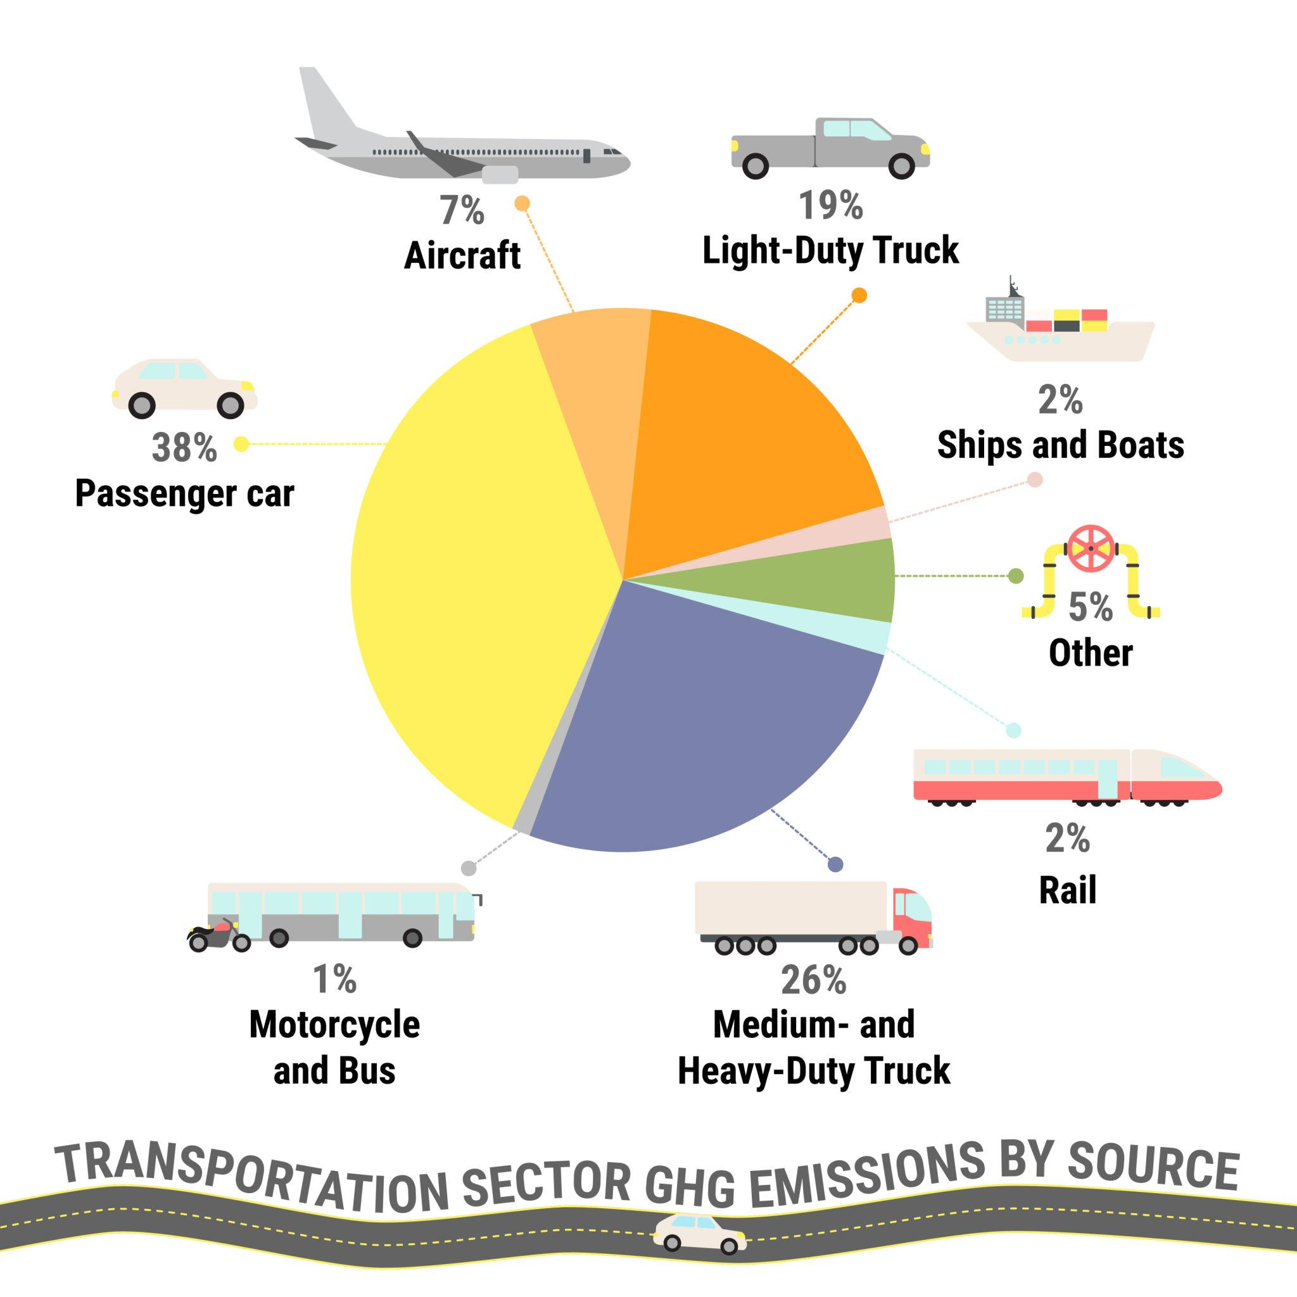

Slide 13
Global Transport Energy Crisis
Increasing vehicle density causes rapid fuel depletion.
Major concerns include greenhouse gas emissions, global warming, and urban pollution.
HEVs provide an intermediate technological solution.

Slide 14
Thermodynamic Limitation of IC Engines
Thermal efficiency of spark ignition engines: 25–30%.
Diesel engines: 30–35%.
Energy losses: Exhaust heat (35%), Cooling losses (30%), Friction losses (10%).
This inefficiency motivates hybridization.

Slide 15
Energy Wastage During Braking
In conventional vehicles, kinetic energy during braking is converted entirely into heat through friction brakes.
This wasted energy can be recovered using regenerative braking in HEVs.

Slide 16
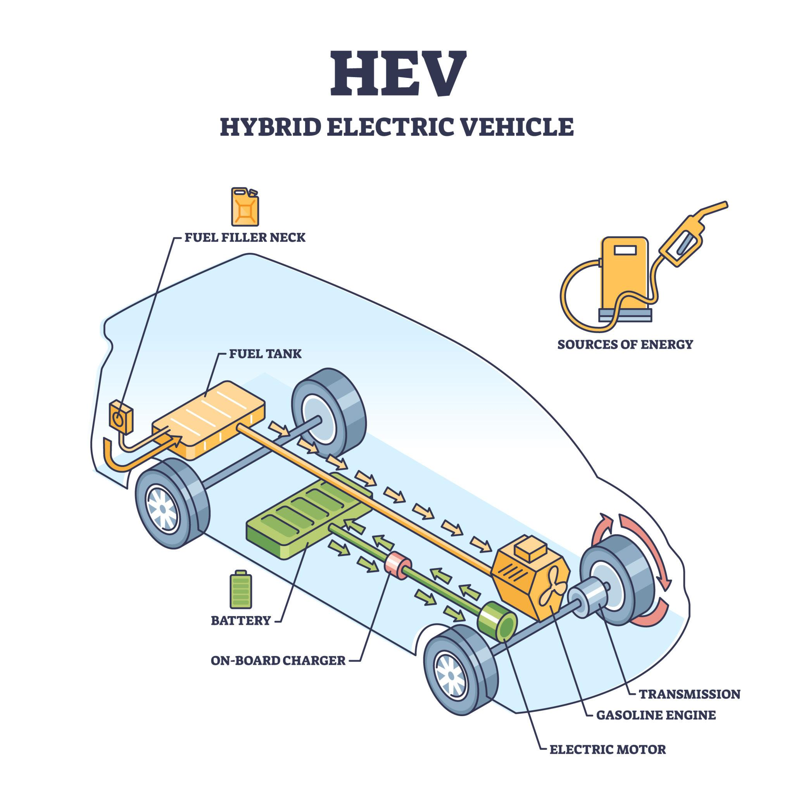

Slide 17
Definition & Operating Philosophy of HEV
HEV integrates two propulsion systems:
IC Engine + Electric Motor.
The control strategy ensures the engine operates near its optimal efficiency zone while the motor assists during transient loads.

Slide 18
Modes of Operation in HEVs
1. Engine-only mode (Highway)
2. Motor-only mode (Low speed)
3. Combined mode (Acceleration)
4. Regenerative braking mode

Slide 19
Detailed HEV Architecture with Power Flow
Internal Combustion Engine
Motor / Generator
Battery Pack
Transmission & Wheels

Slide 20
Energy Flow Analysis
Chemical Energy (Fuel) →
Mechanical Energy (Engine) →
Electrical Energy (Generator) →
Chemical Storage (Battery) →
Electrical →
Mechanical (Motor) →
Vehicle Motion

Slide 21
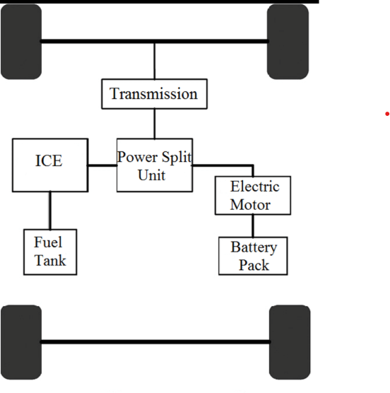

Slide 22
Mathematical Efficiency Analysis
Overall efficiency of series HEV:
η_total = η_engine × η_generator × η_motor
If η_engine=0.35, η_gen=0.9, η_motor=0.92
η_total ≈ 0.29 (29%)

Slide 23
Power Balance Equation
Total propulsion power required:
P_total = P_engine + P_motor
This allows load sharing and downsizing of the engine.

Slide 24
Battery Energy Equation
Stored Energy = V × I × t
Energy capacity (kWh) = Voltage × Ampere-hour / 1000

Slide 25
Fuel Saving
Vehicle distance = 20,000 km/year
ICE mileage = 14 km/l
HEV mileage = 24 km/l
Fuel ICE = 1428 L
Fuel HEV = 833 L
Saving = 595 L per year

Slide 26
CO₂ Reduction
CO₂ emission factor = 2.3 kg/L
Fuel saved = 595 L
CO₂ reduction = 1368.5 kg/year

Slide 27
Regenerative Energy
Mass = 1500 kg
Speed = 72 km/h (20 m/s)
E = 1/2 mv²
E = 0.5 ×1500×400 = 300,000 J
If regen efficiency = 60%
Recovered energy = 180,000 J

Slide 28
Advantages of Hybridization
• Improved fuel economy
• Reduced engine size
• Lower emissions
• Energy recovery capability

Slide 29
Limitations
• Higher cost
• Battery degradation
• Complex control algorithms

Slide 30
Control Strategy in HEVs
Energy Management System determines power split based on:
State of Charge (SOC)
Driver demand
Vehicle speed

Slide 31
SOC Operating Range
Battery SOC typically maintained between 40–80% to maximize lifespan and efficiency.

Slide 32
Lifecycle Emission Analysis
Manufacturing emissions + Operating emissions + Recycling emissions.
HEVs reduce lifecycle emissions compared to ICE vehicles.

Slide 33
Comparison with EV
HEV: Smaller battery, no charging dependency.
EV: Zero tailpipe emission but depends on grid mix.

Slide 34
Indian Context & Policy
FAME(Faster Adoption and Manufacturing of Electric Vehicles)-II scheme promotes electrified vehicles.
BS6 norms require lower emissions.
Hybrid technology supports compliance.

Slide 35
Conclusion
Hybrid Electric Vehicles significantly enhance fuel efficiency and reduce emissions.
They represent a crucial transitional technology toward full electrification.

